Slide 1

Create model with transferred features
Notes:
1

Slide 2
Objectives
Understand transfer learning from the inception model
Implement model with transferred features
Create model with transferred features
2

Slide 3
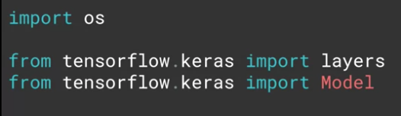
Transfer learning from the inception
The input: using the keras layers API, to pick at the layers, and to understand which ones we want to use, and which ones we want to retrain.
Pretrained weights url: https://storage.googleapis.com/mledu-datasets/inception_v3_weights_tf_dim_ordering_tf_kernels_notop.h5
Create model with transferred features
3
Notes:
3

Slide 4
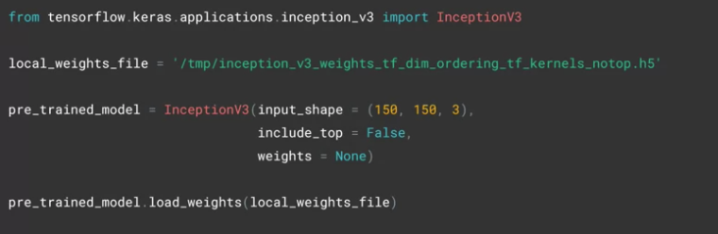
Transfer learning from the inception
The desired input shape for your data.
The inception V3 has a fully-connected layer at the top: setting include_top to false, you're specifying that you want to ignore this and get straight to the convolutions
Create model with transferred features
4
Notes:
4

Slide 5
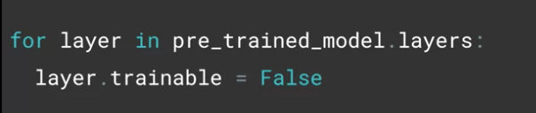
Transfer learning from the inception
Using this code, we can iterate through the layers of the pre-trained model and set them as non-trainable by applying a lock, indicating that they won't undergo further training.
Create model with transferred features
5
Notes:
5

Slide 6
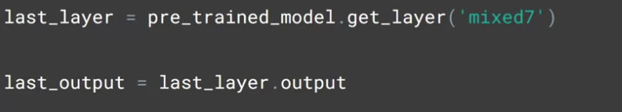
Implement model with transferred features
Choose ‘mixed7’ as the last layer of your base model
Create model with transferred features
6
Notes:
6

Slide 7
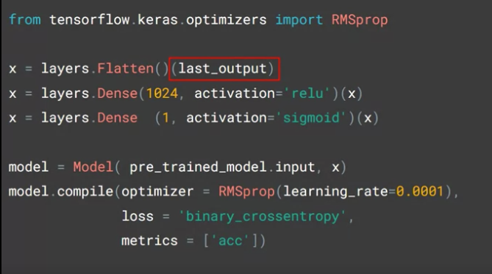
Implement model with transferred features
Define our new model, taking the output from the inception model's mixed7 layer, which we had called last_ouput
Create model with transferred features
7
Notes:
7

Slide 8
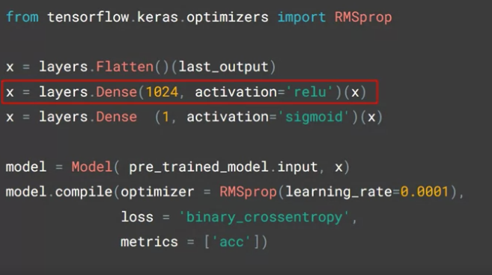
Implement model with transferred features
Add a Dense hidden layer
Create model with transferred features
8
Notes:
8

Slide 9
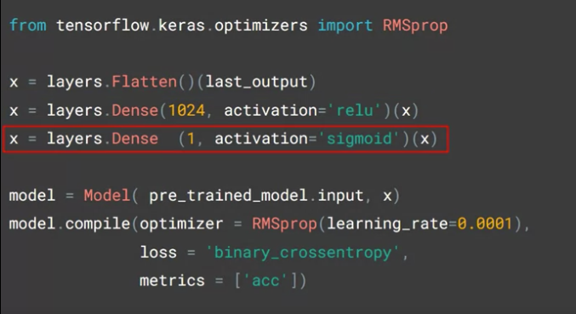
Implement model with transferred features
Output layer which has just one neuron activated by a sigmoid to classify between two items
Create model with transferred features
9
Notes:
9

Slide 10
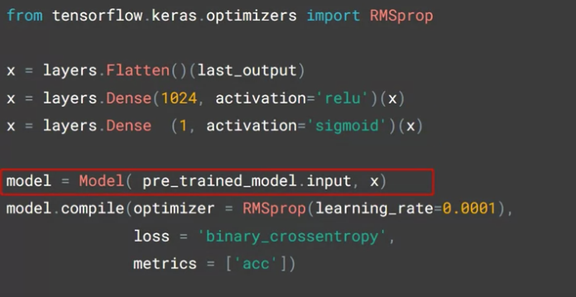
Implement model with transferred features
Create a model using the Model abstract class: passing at the input and the layers definition that you've just created.
Create model with transferred features
10
Notes:
10

Slide 11
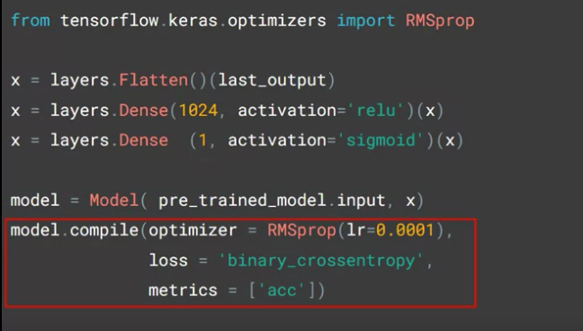
Implement model with transferred features
Compile it as before with an optimizer and a loss function and the metrics that you want to collect.
Create model with transferred features
11
Notes:
11

Slide 12
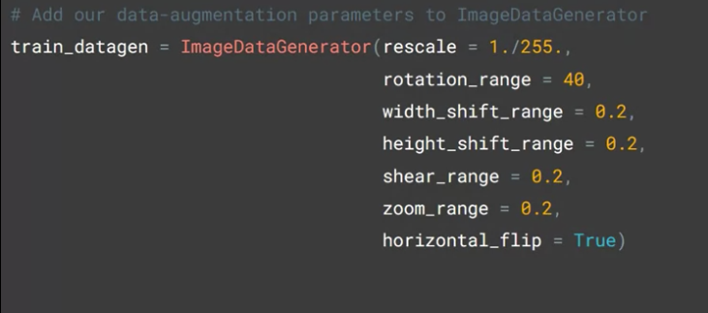
Implement model with transferred features
Augment the images with the image generator
Create model with transferred features
12
Notes:
12

Slide 13
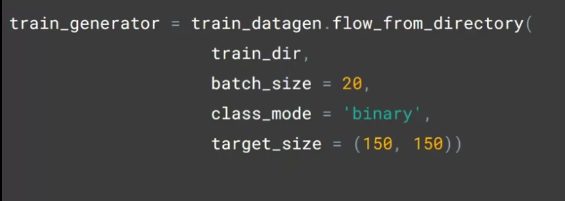
Implement model with transferred features
Get our training data from the generator by flowing from the specified directory and going through all the augmentations
Create model with transferred features
13
Notes:
13

Slide 14
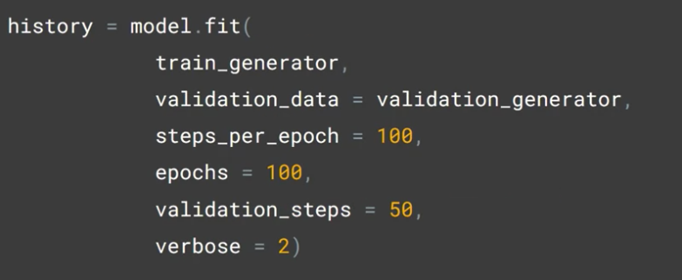
Implement model with transferred features
Train as before with model.fit_generator: 100 epochs.
Create model with transferred features
14
Notes:
14

Slide 15
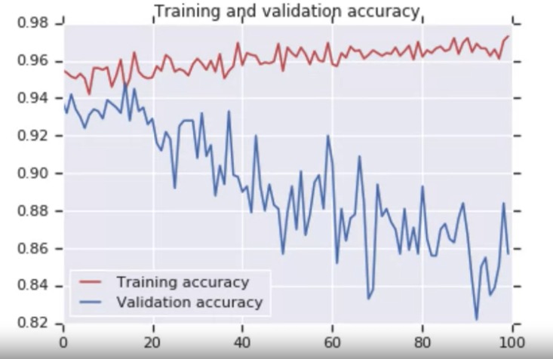


Implement model with transferred features
Give your opinion about this result.
Create model with transferred features
15
Notes:
15

Slide 16
Summary
Understand transfer learning from the inception model
Implement the model with transferred features
Create model with transferred features
16

Slide 17
Q & A
Create model with transferred features
17

